Slide 1
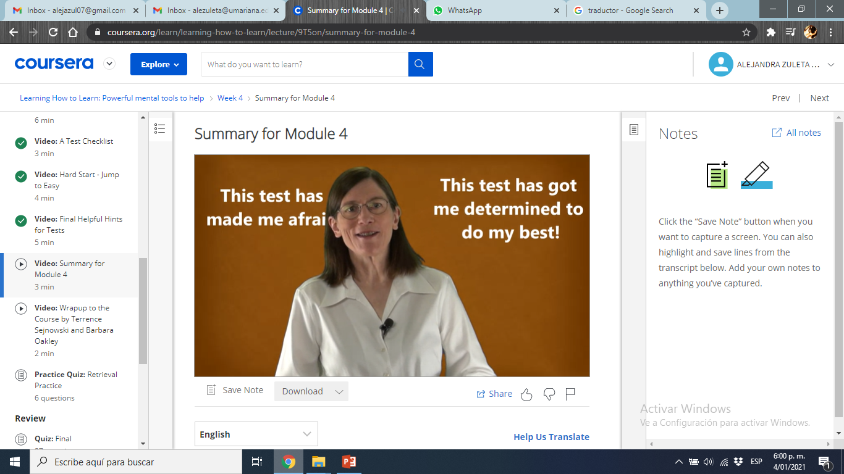
Use your own words and voice
Place your screenshot here

Slide 2
Test Takers
Face your fears.
Have a plan B.
Good worry vs Bad Worry.
Use your check lists.
Does this really have sense?

Slide 3
I am master of my habits

Slide 4
Procrastination
Faced with a challenge, our brain goes to easiest and more pleasure activities.
Procrastinate id related to adictions and has several negative consecuences.
Take care of rewards

Slide 5

How do you procrastinate?

Slide 6
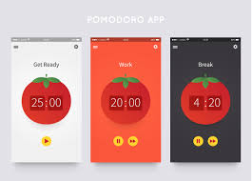
Recommended App: Pomodoro

Slide 7
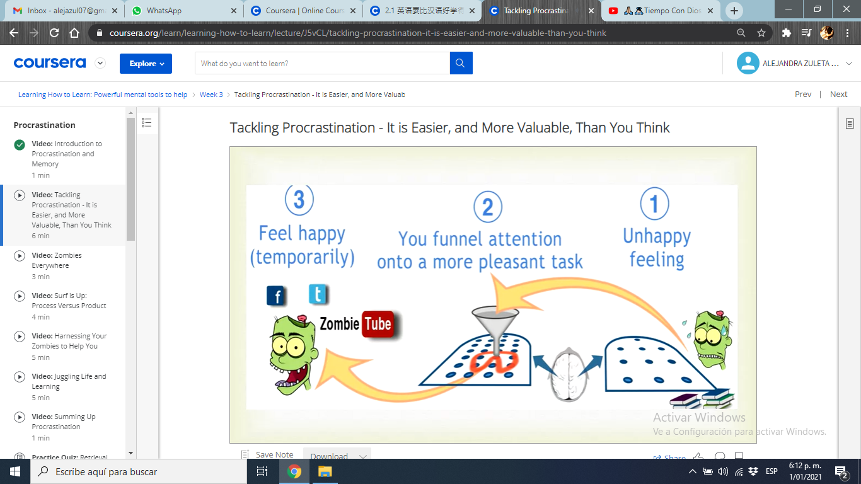
TAKE ADVANTANGE OF YOUR ZOMBIES*
Trackling procrastination y easier than you believe.
*Zombies means: automated thinking or actions.
Place your screenshot here

Slide 8
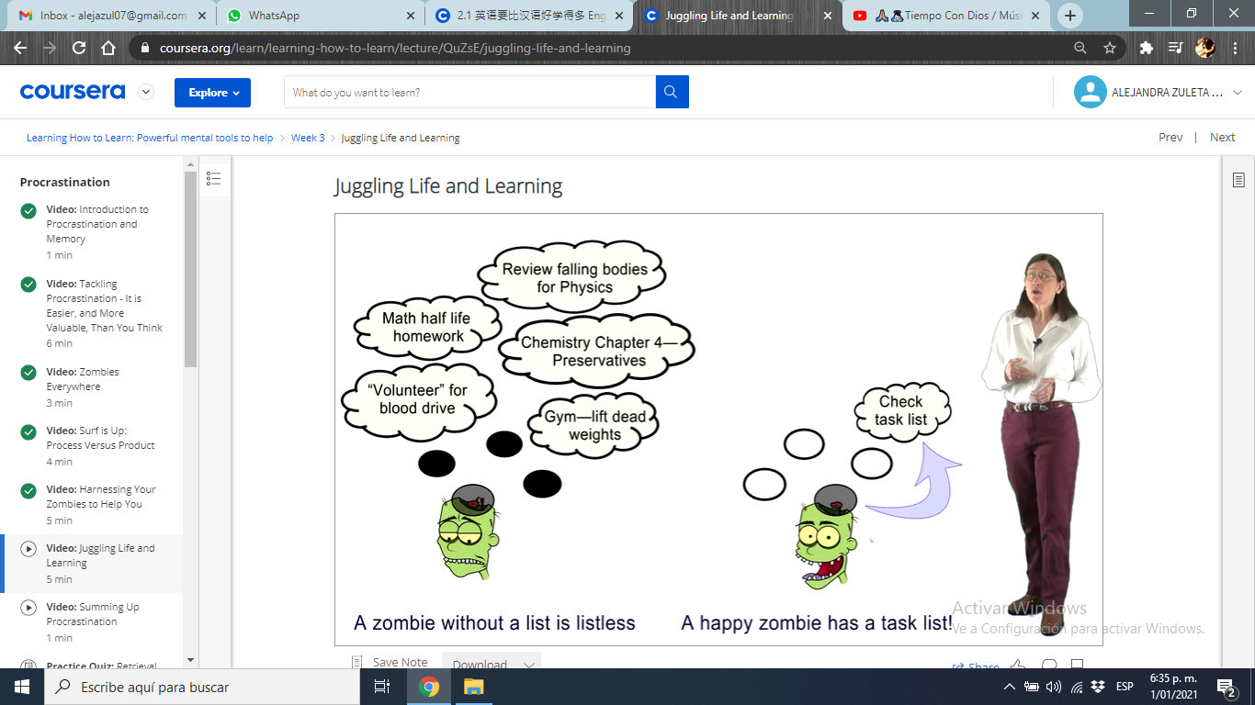
TO DO LIST
Plan your quitting time.
The best time for your to do list is the night, before sleep.
Activate yor difuse mode.
Try to do it weekly.
Place your screenshot here

Slide 9
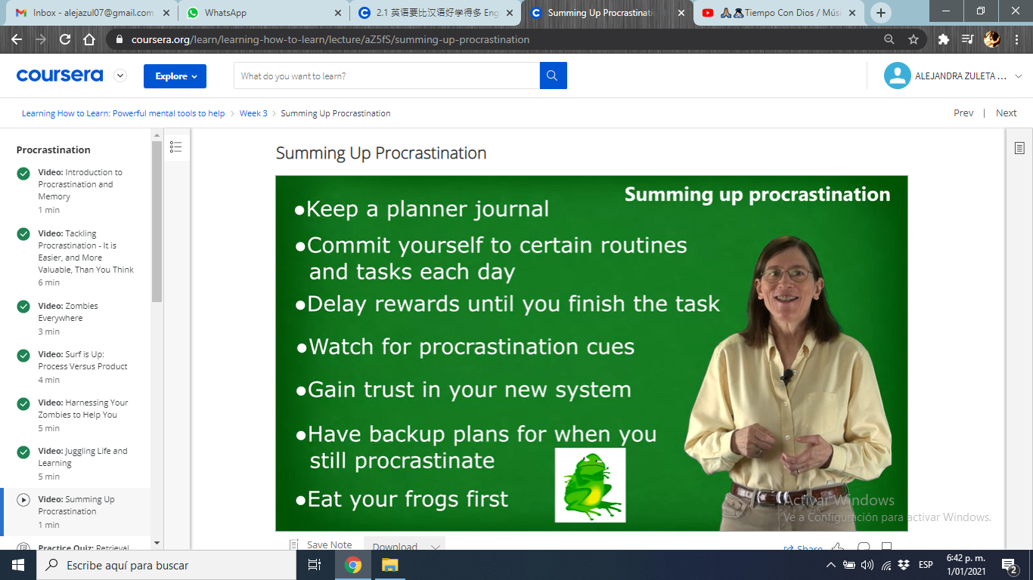
TIPS FOR SUMMING UP PROCRASTINATION
Eat your frogs first: to do the more difficult or dislike activities first.
Place your screenshot here

Slide 10
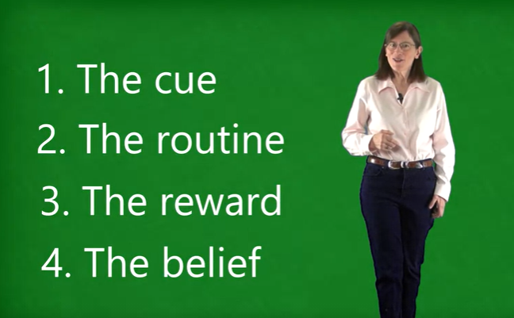
HABITS TO LEARN
Professor Barbara gives us 4 steps to a better learning process and avoid procrastination.
Place your screenshot here

Slide 11
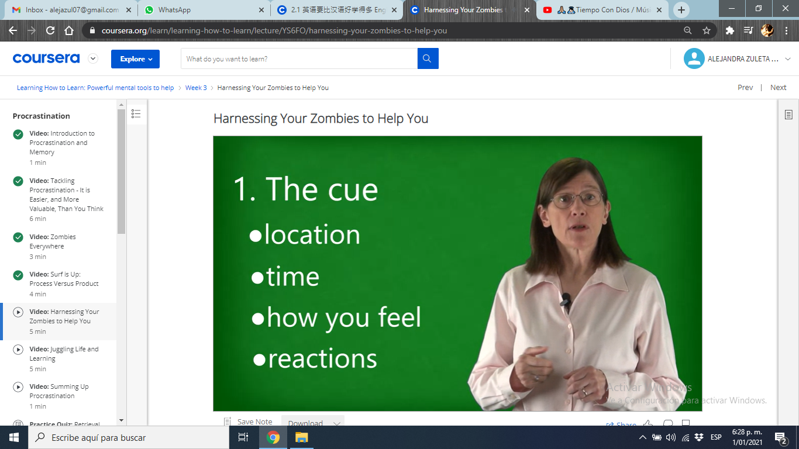
THE CUE
Locate yourself in your space.
Organize your time.
Feel good: mentalize it.
Have good reactions.
Place your screenshot here

Slide 12
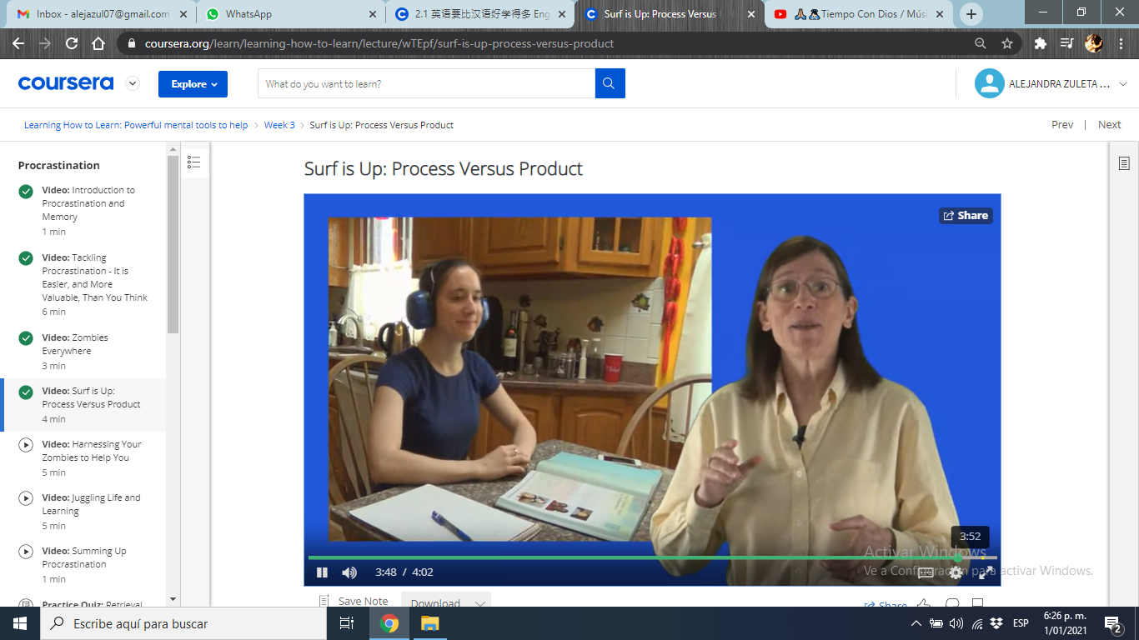
¡BE FOCUS!
Distraction means you're going to have more difficulty in making a chunk, because your brain is not really focusing on chunking the new material
Place your screenshot here

Slide 13
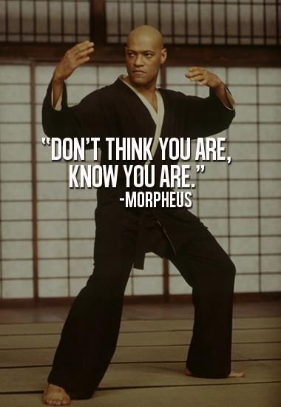
You are, you can
Source: https://www.pinterest.at/pin/260294053439364020/

Slide 14
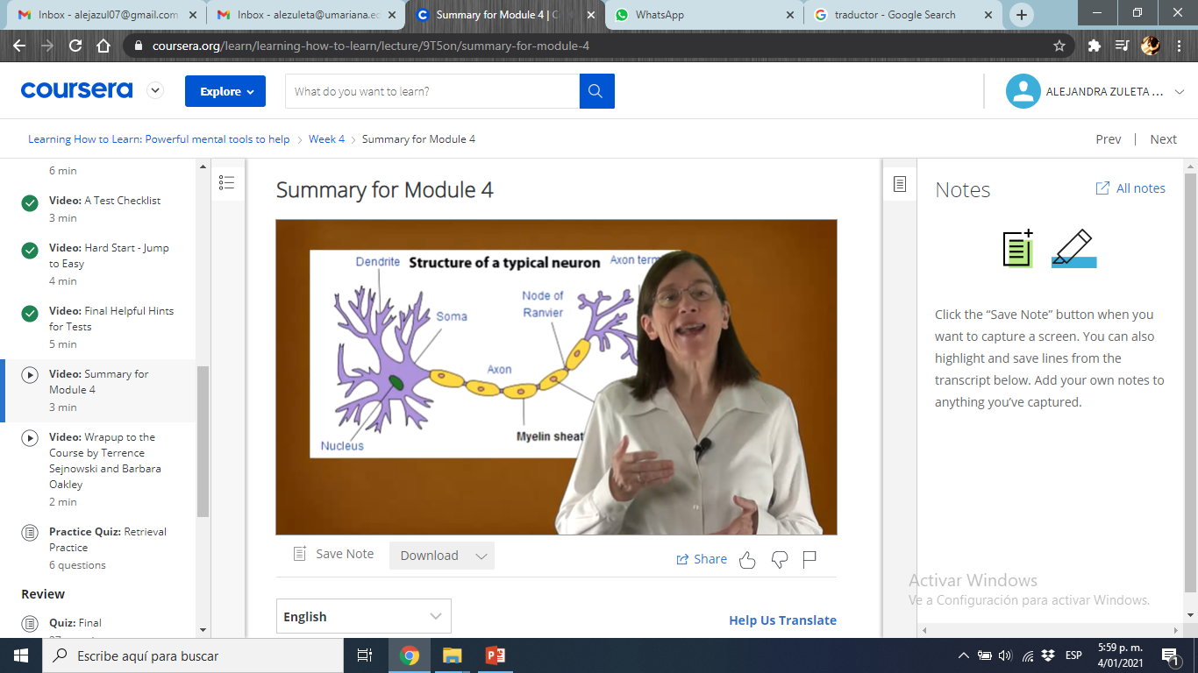
Change your self
Your neurons are flexible and growing.
Place your screenshot here

Slide 15
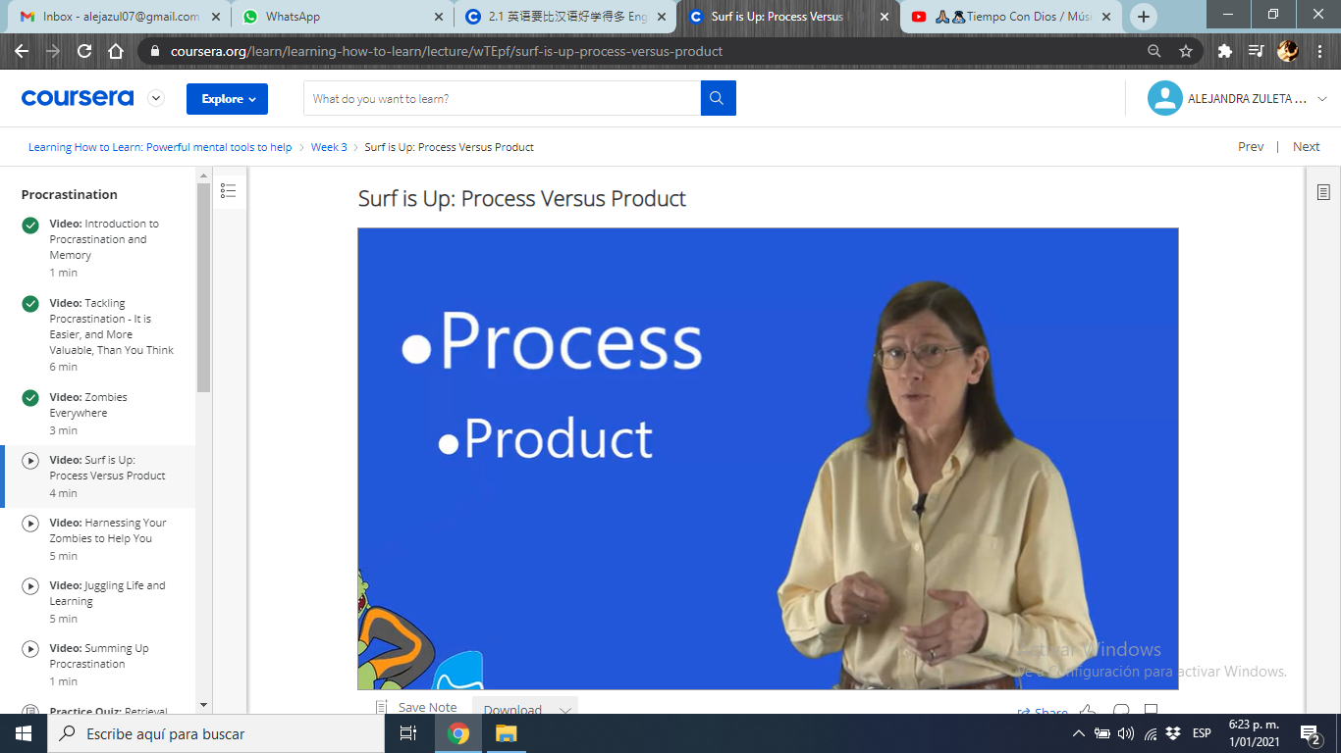
EFFECTIVE LEARNING
To better your learning is necessary t be focus is the process not the product.
Example: Think in all the process that your mind is making to learn maths, not only in the homework.
Place your screenshot here

Slide 16
How to become a better learner
New experiences mantain your brain active (music, languages…)
Mind games.
Take advantage your zombies.
Build in solid.
When you seem to take an exasperating step backwards in your understanding.
Get inspiration in biographies.
Practice and perseverance.

Slide 17
Brains don´t have a tutorial,so write your own.

Slide 18

THANKS!
Any questions?

